Slide 1

Location-Based Social Networks
Yu Zheng
Ph.D., Researcher
IEEE/ACM Senior Member
Microsoft Research Asia
yuzheng@microsoft.com

Slide 2
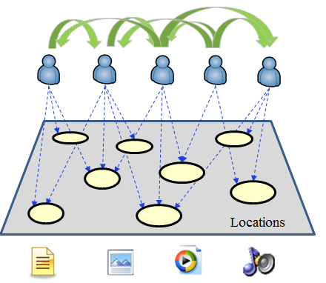
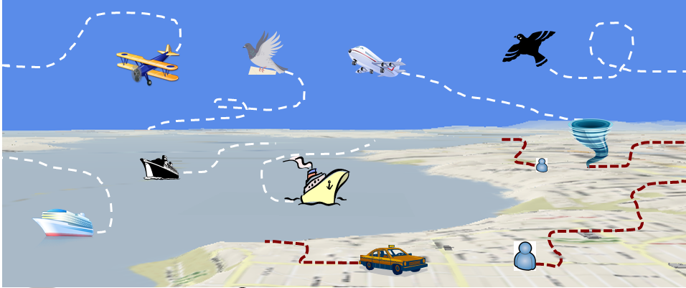
My Research Background
Location-Based Social Networks
Urban Computing
Computing with Spatial Trajectories

Slide 3
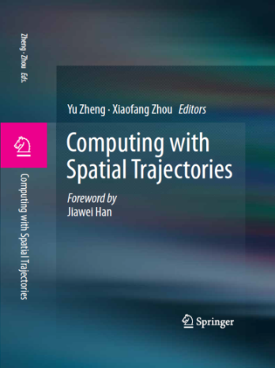
Outline
Chapter 8 (Location-based social networks: Users)
Concepts, definition, and research philosophy
Modeling user location history
Computing user similarity based on location history
Friend recommendation and community discovery
Chapter 9 (Location-based social networks: Locations)
Generic travel recommendations
Mining interesting locations and travel sequences
Trip planning and itinerary recommendation
Location-activity recommendation
Personalized travel recommendation
User-based collaborative filtering
Item-based collaborative filtering
Open challenges

Slide 4
Agenda of the Tutorial
Part I: Concepts, Definition, and Research philosophy
Part II: Understanding Users
Break(20 minute)
Part III: Understanding Locations

Slide 5
Part I: Concepts, Definition, and Research Philosophy

Slide 6

Social Networks
“A social network is a social structure made up of individuals connected by one or more specific types of interdependency, such as friendship, common interests, and shared knowledge.”
Part I: Concepts, Definition, and Research philosophy

Slide 7




Social Networking Services
A social networking service builds on and reflects the real-life social networks among people through online platforms such as a website, providing ways for users to share ideas, activities, events, and interests over the Internet.
Part I: Concepts, Definition, and Research philosophy

Slide 8
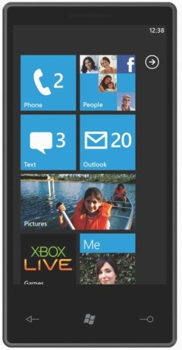
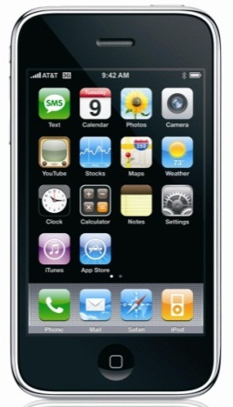
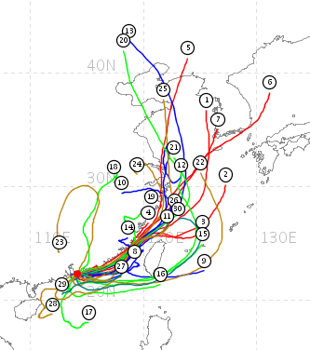

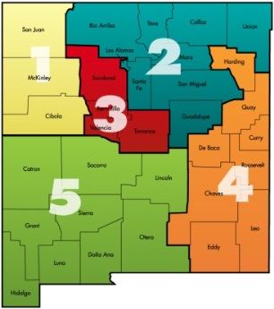
Locations
Location-acquisition technologies
Outdoor: GPS, GSM, CDMA, …
Indoor: Wi-Fi, RFID, supersonic, …
Representation of locations
Absolute (latitude-longitude coordinates)
Relative (100 meters north of the Space Needle)
Symbolic (home, office, or shopping mall)
Forms of locations
Point locations
Regions
Trajectories
Part I: Concepts, Definition, and Research philosophy

Slide 9


Locations + Social Networks
Add a new dimension to social networks
Geo-tagged user-generated media: texts, photos, and videos, etc.
Recording location history of users
Location is a new object in the network
Bridging the gap between the virtual and physical worlds
Sharing real-world experiences online
Consume online information in the physical world
Part I: Concepts, Definition, and Research philosophy

Slide 10
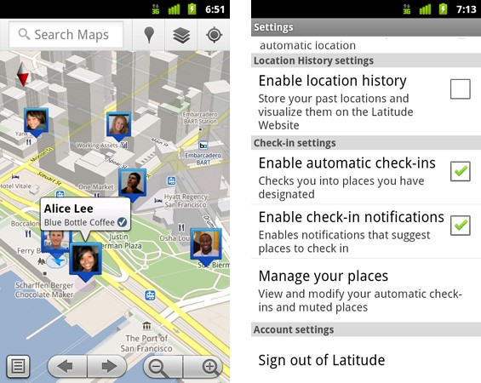
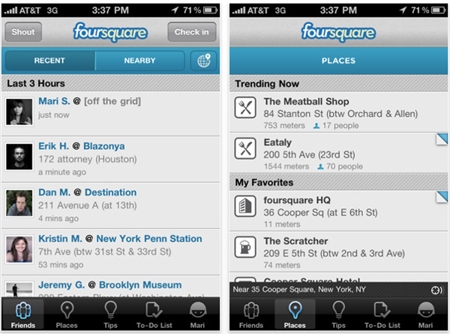
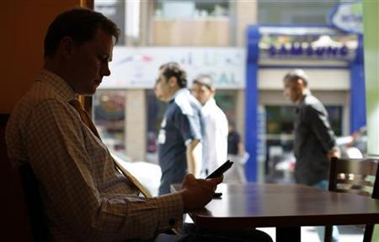
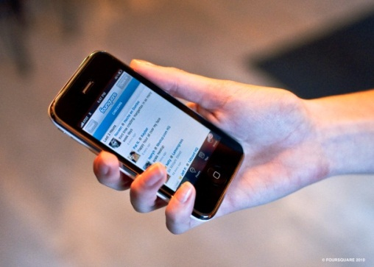
Examples
Virtual world
Sharing &
Understanding
Interactions
Generating &
Consuming
Physical world
Part I: Concepts, Definition, and Research philosophy

Slide 11


Location-Based Social Networks
Sharing
Geo-tagged media
Virtual ←→ Physical worlds
Understanding
User interests/preferences
Location property
User-user, location-location, user-location correlations
Locations
An new dimension: Geo-tag
An new object
Social networks
Expanding social structures
Recommendations
Users
Locations
media
Sharing
Locations
Understanding
Social networks
Part I: Concepts, Definition, and Research philosophy

Slide 12


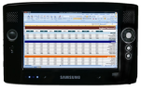


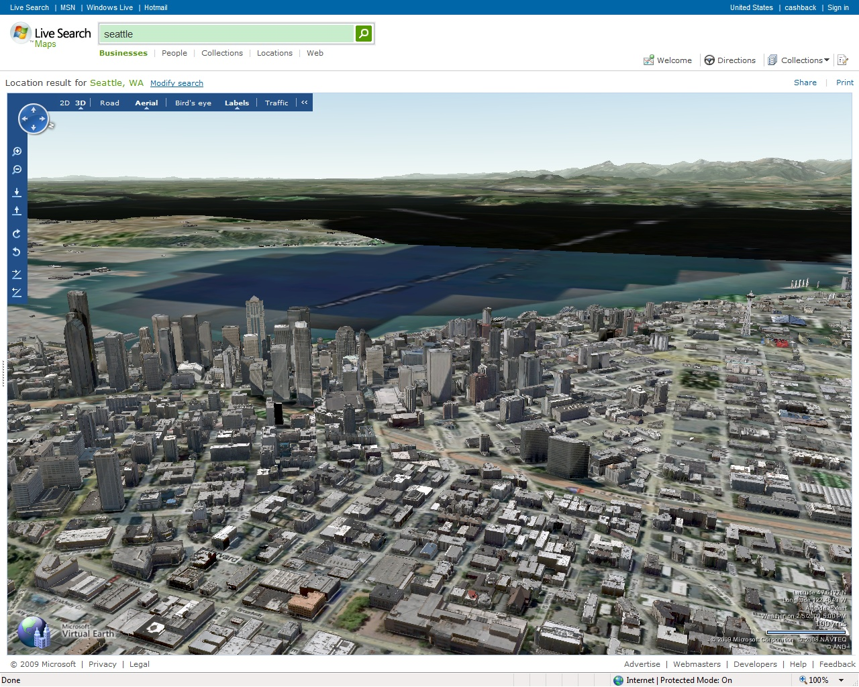

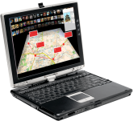


Scenarios - Sharing
Data +
Intelligence
Microsoft Services
Third Party Services
Part I: Concepts, Definition, and Research philosophy

Slide 13

Scenarios - Understanding
Data→ Information → Knowledge → Intelligence
Data +
Intelligence
Microsoft Services
Third Party Services
Part I: Concepts, Definition, and Research philosophy

Slide 14
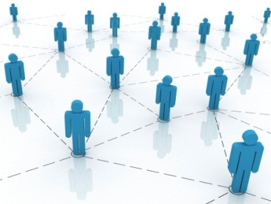
Location-Based Social Networks (LBSNs)
not only mean adding a location to an existing social network so that people in the social structure can share location-embedded information,
but also consists of the new social structure made up of individuals connected by the interdependency derived from their locations in the physical world as well as their location-tagged media content
Here, the physical location consists of the instant location of an individual at a given timestamp and the location history that an individual has accumulated in a certain period.
The interdependency includes not only that two persons co-occur in the same physical location or share similar location histories
but also the knowledge, e.g., common interests, behavior, and activities, inferred from an individual’s location (history) and location-tagged data.
From Book “Computing With Spatial Trajectories”
Part I: Concepts, Definition, and Research philosophy

Slide 15
What’s the difference between
Mobile social networks
Locations
SMS, Bluetooth
Mobile UI
Emphasize the access channels
Location-based social networks
Emphasize the essential difference

Slide 16





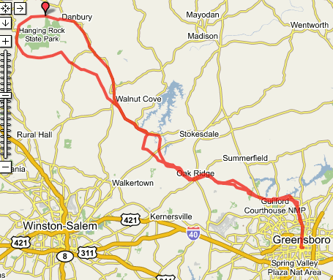

Categories of LBSN Services
Geo-tagged-media-based
Point-location-driven
Trajectory-centric
Geo-
LBSN Services | Focus | Real-time | Information
Geo-tagged-media-based | Media | Normal | Poor
Point-location-driven | Point location | Instant | Normal
Trajectory-centric | Trajectory | Relatively Slow | Rich
Part I: Concepts, Definition, and Research philosophy

Slide 17
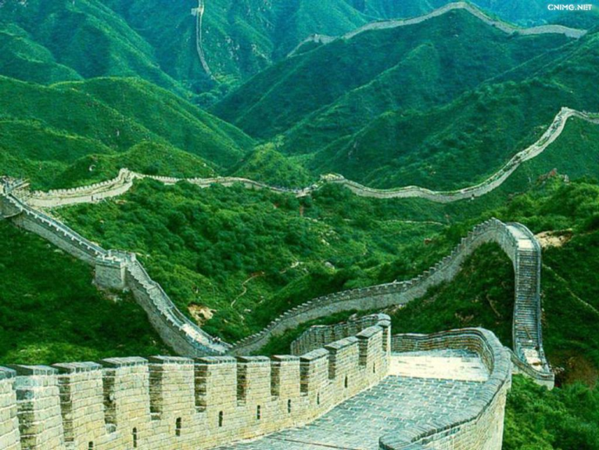

Slide 18
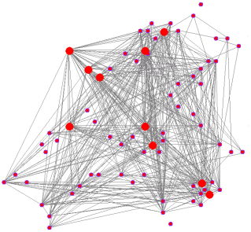

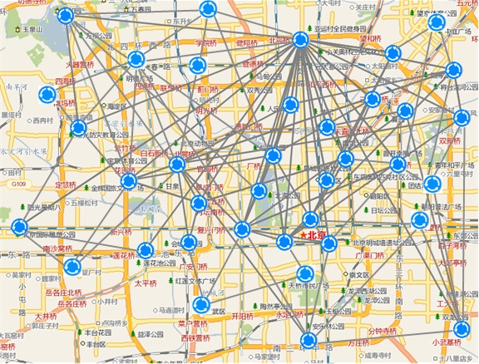

Research Philosophy
User Graph
Users
User Correlation
User-Location Graph
Trajectories
Locations
Location Correlation
Location-tagged user-generated content
Location Graph
Part I: Concepts, Definition, and Research philosophy

Slide 19

Research Philosophy
Sharing
Making sense of the data
Effective and efficient information retrieval
Human computer interaction
……
Part I: Concepts, Definition, and Research philosophy

Slide 20
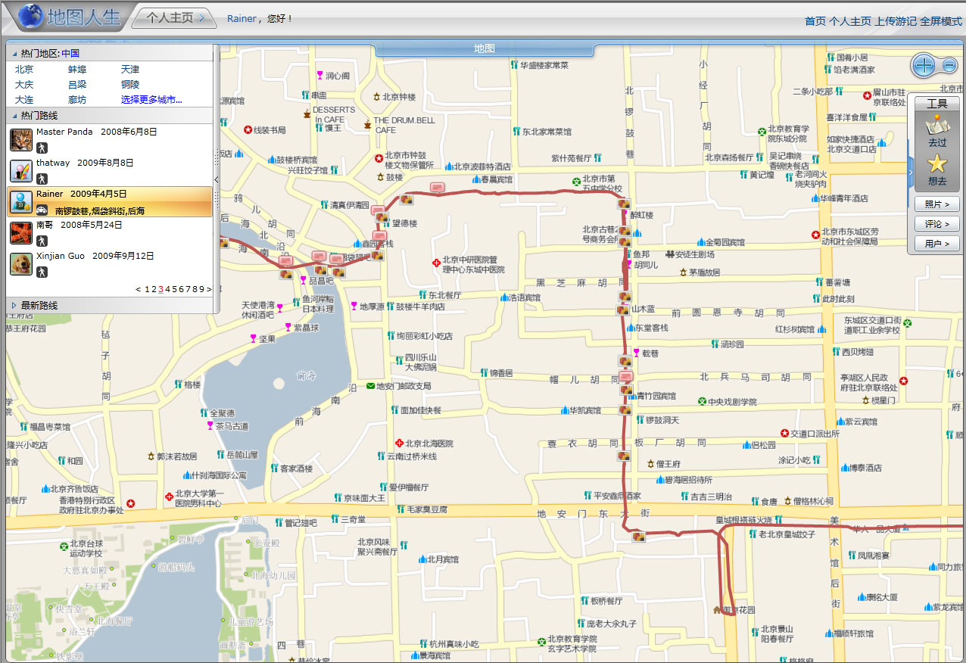
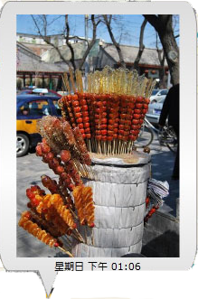
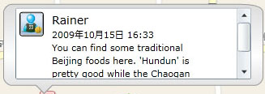
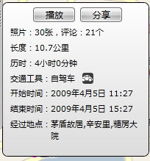

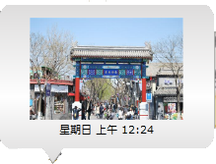

Replay
Share
Replay travel experiences on a map with a GPS trajectory
Notes:
Application scenario: replaying and sharing travel experience with GPS trajectories.
Research points: learning a user’s transportation modes, such as walking and driving, based on GPS data.
Achievements: Publications on WWW2008, Ubicomp 2008, TWEB.
Mentioned in Chapter 6

Slide 21



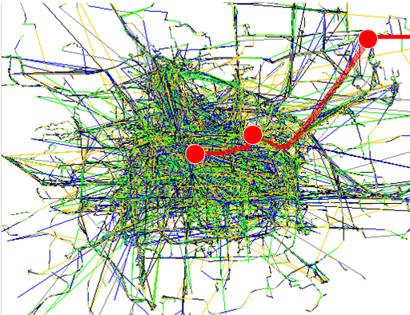
Part I: Concepts, Definition, and Research philosophy
Notes:
Mentioned in Chapter 2.
SIGMOD 2010

Slide 22

Research Philosophy
User Graph
Understanding
Understanding users
Understanding locations
Understanding events
Location Graph
Part I: Concepts, Definition, and Research philosophy

Slide 23


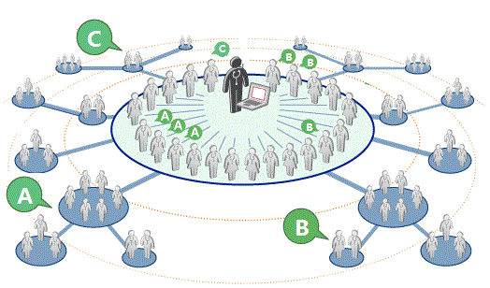
Understanding Users
User similarity/
link prediction
Experts/Influencers detection
Community Discovery
Part I: Concepts, Definition, and Research philosophy

Slide 24

Understanding Locations
Generic recommendation
Most interesting locations and travel routes/sequences
Itinerary planning
Location-activity recommenders
Personalized recommendation
Location recommendations
User-based collaborative filtering model
Item-based collaborative filtering model
Open challenges
Part I: Concepts, Definition, and Research philosophy

Slide 25
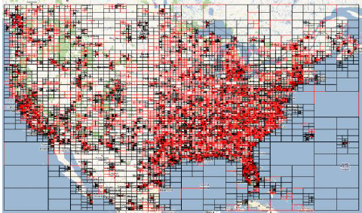
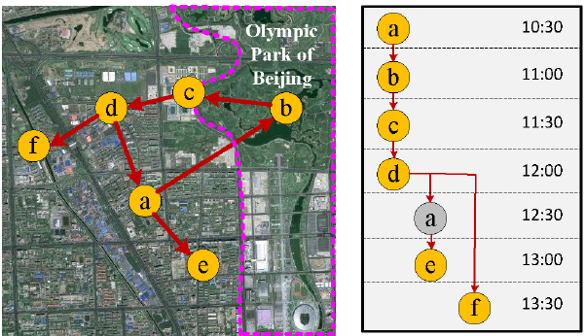
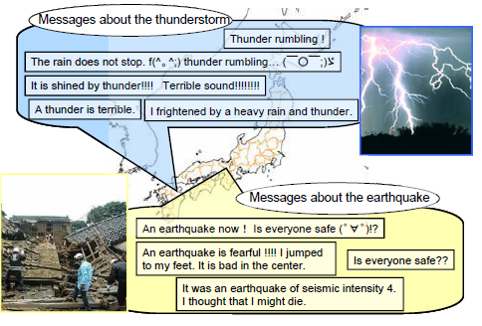
Understanding Events
Anomaly
Crowd Behavioral Patterns
Part I: Concepts, Definition, and Research philosophy

Slide 26
New Challenges in LBSNs
Conferences
Authors
Papers
Heterogeneous networks
Locations and users
Geo-tagged media and trajectories
Special properties
Hierarchy / granularity
Sequential property
Fast evolving
Easy to access a new location
User experience/knowledge changes
Locations
Users
Media
Part I: Concepts, Definition, and Research philosophy

Slide 27
Summary of Part I (Questions 1-5)
Location is not only a dimension but also an object
Two major tasks: Sharing and understanding
Three kinds of location-based social networking services
Unique challenges
Part I: Concepts, Definition, and Research philosophy

Slide 28


Slide 29
Part II: Understanding Users
Modeling user location history in geographic spaces
Computing user similarity in LBSNs
Friend recommendations
Community discovery
Modeling user location history in semantic spaces

Slide 30
Model User Location History
Make a user’s location data computable
Study a user’s preferences and interests
Enable recommendations
Make different users’ data comparable
Part II: Understanding users

Slide 31
Model User Location History
Different types of data in different LBSNs
Geo-tagged-media-based
Point-location-driven
Trajectory centric
Part II: Understanding users

Slide 32
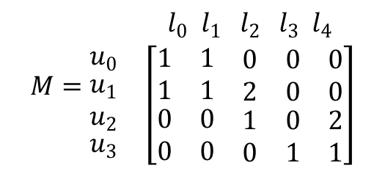
Model User Location History
User-Location Matrix
Works for the point-location-driven LBSNs
A point of interest (POI) is a location
An entry denotes the number of visits to a locations
Point-location-driven
$$M=\begin{matrix} & l_{0} l_{1} { l}_{2} { l}_{3} l_{4} \\ \begin{matrix}u_{0} \\ \begin{matrix}u_{1} \\ u_{2}\end{matrix} \\ u_{3}\end{matrix} & \left[\begin{aligned}\begin{matrix}1 & 1 & \begin{matrix}0 & 0 & 0\end{matrix} \\ 1 & 1 & \begin{matrix}2 & 0 & 0\end{matrix}\end{matrix} \\ \begin{matrix}0 & 0 & \begin{matrix}1 & 0 & 2\end{matrix} \\ 0 & 0 & \begin{matrix}0 & 1 & 1\end{matrix}\end{matrix}\end{aligned}\right]\end{matrix}$$
Part II: Understanding users

Slide 33

Model User Location History
How to define a location in the other two LBSNs
Granularity: a community, a building, a parking place, GPS coordinates
Imprecise locality:
Different sampling rate
Positioning errors
Different access points
Two users traveling on the same route
Part II: Understanding users

Slide 34
Model User Location History
Geo-tagged-media-based
Trajectory centric
User locations → Trajectory data
Detect stay points from trajectories
Using spatial and temporal thresholds
A sequence of stay points
Reduce computing complexity
Carry more semantic meanings
Part II: Understanding users

Slide 35
Model User Location History
1. Stay point detection
2. Hierarchical clustering
3. Individual graph building

Slide 36


Slide 37
Mining User Similarity Based on Location History
References:
[1] Quannan Li, Yu Zheng, Xing Xie, Yukun Chen, Wenyu Liu, Wei-Ying Ma. Mining user similarity based on location history. In ACM SIGSPATIAL GIS 2008. ACM Press: 1-10.
Part II: Understanding users

Slide 38
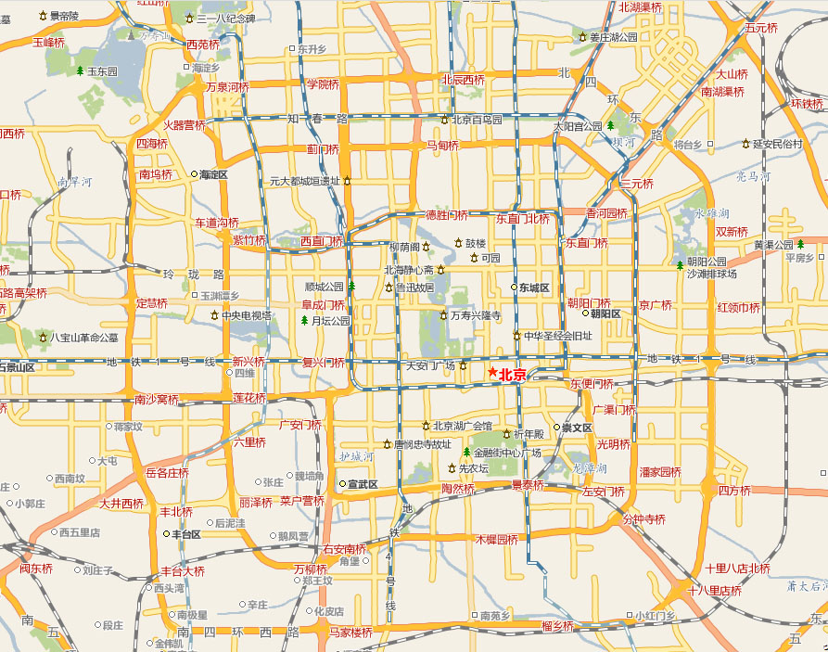





GIS ’08 / ACM TWEB 2011
Grouping users in terms of the similarity between their location histories, and conduct personalized location recommendations.
Notes:
Application scenario: A personalized friends and locations recommendation system
Insight and motivations
Research points: group user in terms of the similarity between their location histories, infer a user’s interest in an unvisited locations, and recommend a user with the locations that the user might be interested in.
Achievements: a publication on GIS 2009, and an accepted paper on ACM Transaction on the Web

Slide 39
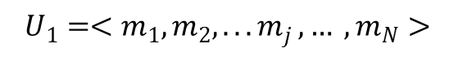
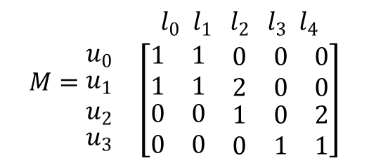
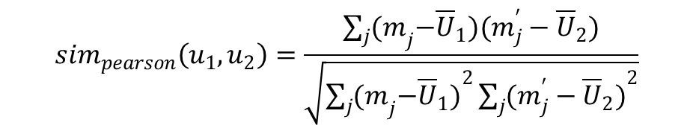
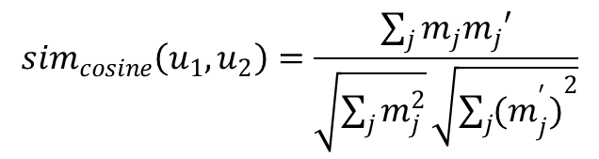
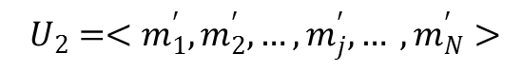
Mining User Similarity Based on Location History
Some naïve methods
Calculated the overlapped locations
The Cosine similarity
The Pearson similarity
$${ U}_{1} =<m_{1}, m_{2}, {...m}_{j}, … , m_{N}>$$
$${ U}_{2} =<m_{1}^{′},m_{2}^{′},…,m_{j}^{′}, … , m_{N}^{′}>$$
$$M=\begin{matrix} & l_{0} l_{1} { l}_{2} { l}_{3} l_{4} \\ \begin{matrix}u_{0} \\ \begin{matrix}u_{1} \\ u_{2}\end{matrix} \\ u_{3}\end{matrix} & \left[\begin{aligned}\begin{matrix}1 & 1 & \begin{matrix}0 & 0 & 0\end{matrix} \\ 1 & 1 & \begin{matrix}2 & 0 & 0\end{matrix}\end{matrix} \\ \begin{matrix}0 & 0 & \begin{matrix}1 & 0 & 2\end{matrix} \\ 0 & 0 & \begin{matrix}0 & 1 & 1\end{matrix}\end{matrix}\end{aligned}\right]\end{matrix}$$
$${sim}_{cosine}\left(u_{1},u_{2}\right)=\frac{\sum_{j}{m_{j}m_{j}′}}{\sqrt{\sum_{j}{m_{j}^{2}}}\sqrt{\sum_{j}{{{(m}_{j}^{′})}^{2}}}}$$
$${sim}_{pearson}\left(u_{1},u_{2}\right)=\frac{\sum_{j}{{(m}_{j}−{\overline{U}}_{1})(m_{j}^{′}−{\overline{U}}_{2})}}{\sqrt{\sum_{j}{{{(m}_{j}−{\overline{U}}_{1})}^{2}}\sum_{j}{{(m_{j}^{′}−{\overline{U}}_{2})}^{2}}}}$$
Part II: Understanding users

Slide 40
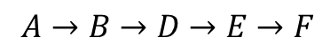
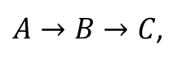
Mining User Similarity Based on Location History
Computing user similarity
Hierarchical properties
Sequential properties
Popularity of a location
$A→B→C$,
$A→B→D→E→F$
Part II: Understanding users

Slide 41
Mining User Similarity Based on Location History
Modeling Location History
A Hierarchical Graph for each individual
Measuring Similarity
A similarity score Sij for each pair of users

Slide 42
Mining User Similarity Based on Location History
Modeling Location History
A Hierarchical Graph for each individual
1. Sequence Matching
2. Similarity Score Calculating
Measuring Similarity
A similarity score Sij for each pair of users
Part II: Understanding users

Slide 43
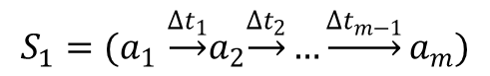
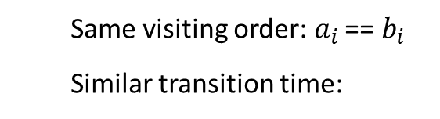

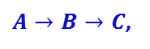
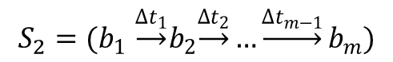
Mining User Similarity Based on Location History
Sequence matching
A pair of similar sequences: two individuals share the property of visiting the same sequence of places with a similar travel time
Find out the maximum-length similar sequence
$$S_{1}{=(a}_{1}\underset{→}{{∆t}_{1}}a_{2}\underset{→}{{∆t}_{2}}…\underset{→}{{∆t}_{m−1}}a_{m})$$
Same visiting order: $a_{i}$ == $b_{i}$
Similar transition time:
$$S_{2}{=(b}_{1}\underset{→}{{∆t}_{1}}b_{2}\underset{→}{{∆t}_{2}}…\underset{→}{{∆t}_{m−1}}b_{m})$$
Two maximum matches (p = 0.2)
$A→B→C$,
$A→B→D→E→F$
Part II: Understanding users

Slide 44
Mining User Similarity Based on Location History
Sequence matching methods
Longest Common Subsequence (LCS)
Dynamic Time Wrapping (DTW)
Not optimal for this application due to the transition duration
An efficient method proposed in
Xiangye Xiao, Yu Zheng, et al. Finding Similar Users Using Category-Based Location History. In GIS 2010
Part II: Understanding users

Slide 45
Mining User Similarity Based on Location History
User 1 ( ): User3 ( ) > User 2 ( )
A→ B
A→ B
User 1: A→ B
User 1: A→ B
User 3: A→ B
User 2: A→ B
c→ e
User 1: a→ c → e
User 1: a→ c → e
User 2: b→d
User 3: b→c → e
Part II: Understanding users

Slide 46
Mining User Similarity Based on Location History
User 1 ( ): User3 ( ) < User 2 ( )
A→ B
User 1: A→ B
C
User 2: A→ B
C
f
User 1: a→ c → e
f
User 1: a→ c → e
g
User 2: b→d
g
User 3: f→g
Part II: Understanding users

Slide 47
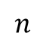


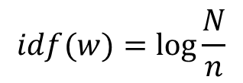
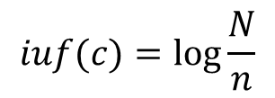
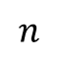
Mining User Similarity Based on Location History
IDF (Inverse document frequency)
IUF (Inverse user frequency)
$$idf(w)=\log{\frac{N}{n}}$$
$$iuf(c)=\log{\frac{N}{n}}$$
Word w
Location c
……
…….
……
…….
……
…….
$$n$$
$$n$$
$$N$$
$$N$$

Slide 48
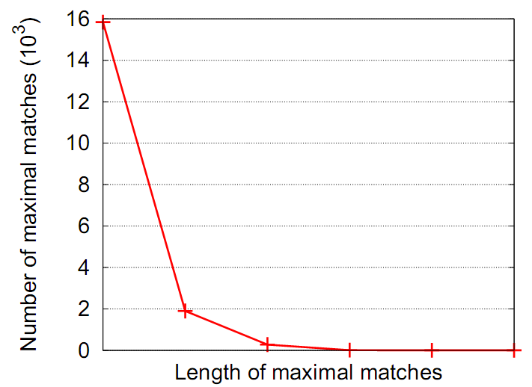
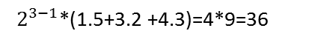
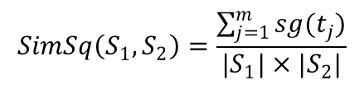
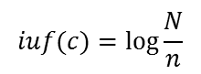





Mining User Similarity Based on Location History
,
,
Similarity Calculating
3. Similarity score between two users
$$SimUser\left(u_{1}, u_{2}\right)=\sum_{l=1}^{L}{f_{w}(l)×SimSq(S_{1}^{l}, S_{2}^{l})}$$
$$SimSq\left(S_{1}, S_{2}\right)=\frac{\sum_{j=1}^{m}{sg(t_{j})}}{|S_{1}|×|S_{2}|}$$
2. Similarity score between two sequences
$$sg\left(s\right)=g_{w}(k)×\sum_{i=1}^{k}{iuf(c_{i})}$$
1. Similarity score of a shared sequence
Weights:
$$f_{w}\left(l\right)=2^{l−1}$$
$$g_{w}\left(k\right)=2^{k−1}$$
Inverse user frequency of a location c:
$$iuf(c)=\log{\frac{N}{n}}$$
1.5
3.2
$2^{2−1}$*(1.5+3.2)=2*4.7=9.4
1.5
3.2
4.3
$2^{3−1}$*(1.5+3.2 +4.3)=4*9=36

Slide 49



Mining User Similarity Based on Location History
Data for evaluation
112 users collecting the data from 2007-2008
Part II: Understanding users

Slide 50

GeoLife Trajectory Dataset (1.1)
Transportation mode | Distance (km) | Duration (hour)
Walk | 11,457 | 5,126
Bike | 6,335 | 2,304
Bus | 21,931 | 1,430
Car & taxi | 34,127 | 2,349
Train | 74,449 | 459
Airplane | 28,493 | 37
Other | 10,886 | 335
Total | 187,679 | 12,041
 | Version 1.0 | Version 1.1 | Incremental
Time span of the collection | 04/2007 – 08/2009 | 04/2007 – 12/2010 | +16 months
Number of users | 155 | 167 | +12
Number of trajectories | 15,854 | 17,355 | +1,501
Number of points | 19,304,153 | 22,294,264 | 2,990,111
Total distance | 600,917 km | 1,070,406 km | +469,489 km
Total duration | 44,776 hour | 48,349 hour | +3,573 hour
Effective days | 8,977 | 9,694 | +717

Slide 51

Link to the data

Slide 52

People’s location history in Beijing

Slide 53
Mining User Similarity Based on Location History
Evaluation approach
Evaluated as an information retrieval problem
Ground truth: user study
Part II: Understanding users

Slide 54
Mining User Similarity Based on Location History
Results represented by NDCG
Part II: Understanding users

Slide 55
Friend and Location Recommendation
Similar Users Retrieval
Ranking Locations
Location Candidates Discovering
L1, L2, …., Ln
u1 u2
.
.
un
x1, x2, …, xn
y1, y2, …, yn
.
.
z1, z2, …, zn
User taste inferring
Yu Zheng, et al. Recommending friends and locations based on individual location history. In ACM Trans. on the Web, 2011.

Slide 56
Community Discovery
Clustering users according to the user similarity
Very time consuming
Performed offline and in a low frequency
Proximate methods
More methods can be found in complex networks
Part II: Understanding users

Slide 57




Slide 58
Modeling User Location History in Semantic Spaces
[1] Xiangye Xiao, Yu Zheng, Qiong Luo, Xing Xie. Finding Similar Users Using Category-Based Location History. In ACM SIGSPATIAL GIS 2010.
[2] Xiangye Xiao, Yu Zheng, Qiong Luo, Xing Xie. Inferring Social Ties between Users with Human Location History. Journal of Ambient Intelligence and Humanized Computing.
Part II: Understanding users

Slide 59

Modeling User Location History in Semantic Spaces
Motivation
People living in different cities, countries, and regions
More informative
Tackle data sparseness: categories < locations
User similarity
Semantic Location history
Geo-Location history
GPS trajectories

Slide 60

Modeling User Location History in Semantic Spaces
Easy for the point-location-driven LBSNs
Challenges for the other two
Difficult to identify the exact place visited
GPS positioning errors
Overlaps between POIs
$$M=\begin{matrix} & c_{0} c_{1} { c}_{2} { c}_{3} c_{4} \\ \begin{matrix}u_{0} \\ \begin{matrix}u_{1} \\ u_{2}\end{matrix} \\ u_{3}\end{matrix} & \left[\begin{aligned}\begin{matrix}1 & 1 & \begin{matrix}0 & 0 & 0\end{matrix} \\ 1 & 1 & \begin{matrix}2 & 0 & 0\end{matrix}\end{matrix} \\ \begin{matrix}0 & 0 & \begin{matrix}1 & 0 & 2\end{matrix} \\ 0 & 0 & \begin{matrix}0 & 1 & 1\end{matrix}\end{matrix}\end{aligned}\right]\end{matrix}$$
Part II: Understanding users

Slide 61

Modeling User Location History in Semantic Spaces
Represent a stay point with a feature vector
$f_{r}=<w_{1},w_{2}…w_{F}>$
$w_{i}=\frac{n_{i}}{N}×log\frac{|R|}{|\{Regions containing i\}|}$
Part II: Understanding users

Slide 62
Modeling User Location History in Semantic Spaces

Slide 63
Summary of Part II (Question 6-9)
Model user location history in geographic and semantic spaces
Identify the similarity between users considering
Location sequences
Location hierarchy
Location popularity
Model user location history in semantic spaces
Future direction
Incorporating more features to compute user similarity
Social structures
Location correlations (travel sequences between locations)
Temporal features (day of the week, time of day)
Sophisticated methods
Co-clustering
Complex networks
Part II: Understanding users

Slide 64
Part III: Understanding Locations
Generic travel recommendations
Mining interesting locations and travel sequences
Trip planning and itinerary recommendation
Location-activity recommendation
Personalized travel recommendation
User-based collaborative filtering
Item-based collaborative filtering
Open challenges

Slide 65
Break [30 minutes]
Return at 11:00am

Slide 66
Part III: Understanding Locations
Generic travel recommendations
Mining interesting locations and travel sequences
Trip planning and itinerary recommendation
Location-activity recommendation
Personalized travel recommendation
User-based collaborative filtering
Item-based collaborative filtering
Open challenges

Slide 67
Mining interesting locations and travel sequences from GPS trajectories
[1] Yu Zheng, Lizhu Zhang, Xing Xie, Wei-Ying Ma. Mining interesting locations and travel sequences from GPS trajectories. In WWW 2009.
Part II: Understanding locations – Generic recommendations

Slide 68
Mining interesting locations, travel sequences, and travel experts from user-generated travel routes
Notes:
Application scenario: Generic travel recommendation and mobile tour guides based on a large number of users’ travel routes
Research points: Mining large-scale trajectory data to infer top interesting locations, classical travel sequences between locations, and travel experts of a geo-region.
Difficulty: the interest level of a location depends on not only the number of users visiting this location but also these users' travel experiences. Meanwhile, the interest level of a location and travel experience of a user has a mutual reinforcement relationship, i.e., a interesting location may be visited by many experienced users and an experienced user could visit many interesting locations. (like the concept of page rank)
Achievement: A publication on WWW2009, TechFest 2009.

Slide 69
Part II: Understanding locations – Generic recommendations

Slide 70
Challenges
What is a location? (geographical scales)
The interest level of a location
does not only depend on the number of users who have visited this location
but also lie in these users’ travel experiences
How to determine a user’s travel experience?
The location interest and user travel
are region-related
are relative value (Ranking problem)
Part II: Understanding locations – Generic recommendations

Slide 71
Methodology
HITS (hypertext induced topic search) model
Authority: a Web page with many in-links
Hub: is a page with many out-links
Mutual reinforcement relationship
Part II: Understanding locations – Generic recommendations

Slide 72
Users:
Hub nodes
The HITS-based inference model
Locations:
Authority nodes

Slide 73
Methodology
1. Stay point detection
2. Hierarchical clustering
3.Graph Building

Slide 74
Methodology
Each user has multiple hub scores w.r.t. different nodes
Choose a hub score according to the specified region
Part II: Understanding locations – Generic recommendations

Slide 75

Detecting Interesting Travel Sequences
Three factors determining the classical score of a sequence:
Travel experiences (hub scores) of the users taking the sequence
The location interests (authority scores) weighted by
The probability that people would take a specific sequence
The classical score of sequence A→C:
: Authority score of location A
: User k’s hub score
: Authority score of location C
Part II: Understanding locations – Generic recommendations

Slide 76


Slide 77
Trip Planning and Itinerary Recommendation
[1] Hyoseok Yoon, Yu Zheng, Xing Xie, Woontack Woo. Smart Itinerary Recommendation based on User-Generated GPS Trajectories. In Proceedings of Ubiquitous Intelligence and Computing (UIC 2010),
[2]Hyoseok Yoon, Yu Zheng, Xing Xie, and Woontack Woo. Social Itinerary Recommendation from User-generated Digital Trails. Journal on Personal and Ubiquitous Computing (PUC).
[3] Hechen Liu, Ling-Yin We, Yu Zheng, Markus Schneider. Route Discovery from Mining Uncertain Trajectories. Demo Paper, to appear in IEEE International Conference on Data Mining (ICDM 2011).
Part II: Understanding locations – Generic recommendations

Slide 78

Problem Definition
Given a origin, a destination, and a time duration
Return a sequence of locations with travel time suggestion
2H
40M
1H
30M
1.5H
1H
1H
30M

Slide 79

Itinerary Recommendation
Learning collective knowledge from user-generated trajectories
Part II: Understanding locations – Generic recommendations

Slide 80
Itinerary Recommendation
What is a good itinerary
A proper time length w.r.t. my time constraint
More time stay in a location rather than travel between locations
More interesting locations contained
Follow other people’s travel sequence pattern
Criteria
Elapsed Time Ratio (ETR): Time given / time spent
Stay Time Ratio (STR): Time stay in an attraction/time spent on the way
Interest Density ratio (IDR): refer to the previous section
Classical Travel Sequence Ratio (CRSR): refer to the previous section
Part II: Understanding locations – Generic recommendations

Slide 81
Itinerary Recommendation
Building a location-interest graph with user-generated data
Infer the interest level of each location
Estimate the average travel time between any two locations
Part II: Understanding locations – Generic recommendations

Slide 82
Itinerary Recommendation
1. Stay point detection
2. Hierarchical clustering
3.Graph Building

Slide 83


Itinerary Recommendation
Candidate selection given a query (O, D, t)
Select top-k sequences according to ETR, STR, and IDR
Calculate the classical travel sequence ratio
Re-rank the sequences by adding CTSR
Part II: Understanding locations – Generic recommendations

Slide 84

Trip Recommendation Using Uncertain Trajectories
Uncertain trajectories
check-ins or geo-tagged photos
Taxi trajectories, trails of migratory birds
...
...
...
...
...
...
Hechen Liu, Ling-Yin We, Yu Zheng, Markus Schneider, Wen-Chih Peng. Route Discovery from Mining Uncertain Trajectories. Demo Paper, ICDM 2011.

Slide 85
Trip Recommendation Using Uncertain Trajectories
Constructing popular routes from uncertain trajectories
Using collective knowledge: The route may not exist in the dataset
Mutual reinforcement learning
...
...
...
...
...
...
...
...
...
...

Slide 86
...
Concatenation
...
...
...
...
...
...
...
Mutual reinforcement construction
...
...
...
...
...
...
...
...

Slide 87
Trip Recommendation Using Uncertain Trajectories
Problem
Given a corpus of uncertain trajectories and
a user query: some point locations and a time constraint
Suggest the top k most popular routes
...
...
...
...
...
...
...
...
...
...
...
...
...
...
...

Slide 88
Itinerary Recommendation
Future work
Advanced candidate selection algorithms
Consider personal preferences
Money cost
Part II: Understanding locations – Generic recommendations

Slide 89







Slide 90
Location-Activity Recommendation
[1] Vincent Wenchen Zheng, Yu Zheng, Xing Xie, Qiang Yang. Collaborative Location and Activity Recommendations With GPS History Data. In WWW 2010), ACM Press: 1029-1038.
[2] Vincent W. Zheng, Yu Zheng, Xing Xie, Qiang Yang. Learning from GPS Data for Mobile Recommendation. Artificial Intelligence Journal.
Part II: Understanding locations – Generic recommendations

Slide 91
Location-Activity Recommendation
Q1: what can I do there if I visit some place?
(Activity recommendation given location query)
Q2: where should I go if I want to do something?
(Location recommendation given activity query)

Slide 92
Problem Definition
How to well model the location-activity relation
Encode it into a matrix
Example
An entry denotes how
popular an activity is
performed at a location
5
5
3
2
4
Ranking along the
Columns or rows
1
Tourism
Exhibition
Shopping
5 | 4 | 2
4 | 3 | 1
1 | 2 | 6
Location recommendation
Tourism:
Forbidden City > Bird’s Nest > Zhongguancun
Forbidden City
Bird’s Nest
Activity recommendation
Forbidden City:
Tourism > Exhibition > Shopping
Zhongguancun

Slide 93
Location-Activity Recommendation
Data sparseness (<0.6% entries are filled)
Tourism
Exhibition
Shopping
Activities
Forbidden City
5 | ? | ?
? | 1 | ?
1 | ? | 6
Bird’s Nest
Locations
?
Zhongguancun
Part II: Understanding locations – Generic recommendations

Slide 94

Solution: Collaborative Location and Activity Recommendation (CLAR)
Collaborative filtering, with collective matrix factorization
Low rank approximation, by minimizing
where U, V and W are the low-dimensional representations for the locations, activities and location features, respectively. I is an indicatory matrix.
Answer Question 14

Slide 95

Location-Activity Recommendation
The objective function is not jointly convex
Using gradient descent to get the local optimal solutions
$∇_{U}L=\left[I∘\left(UV^{T}−X\right)\right]V+λ_{1}\left(UW^{T}−Y\right)W+λ_{3}U$,
$∇_{V}L={\left[I∘\left(UV^{T}−X\right)\right]}^{T}U+{2λ}_{2}\left(VV^{T}−Z\right)V+λ_{3}V$, (6)
$∇_{W}L=λ_{1}{\left(UW^{T}−Y\right)}^{T}U+λ_{3}W$
Reconstruct the incomplete X after getting U* and V*
Efficient: Complexity is linear to number of locations
Part II: Understanding locations – Generic recommendations

Slide 96

Location-Activity Recommendation
Next Step: incorporating users
Vincent W. Zheng, Yu Zheng, Xing Xie, Qiang Yang. Learning from GPS Data for Mobile Recommendation. Artificial Intelligence Journal.

Slide 97





Slide 98
Part III: Understanding Locations
Generic travel recommendations
Mining interesting locations and travel sequences
Trip planning and itinerary recommendation
Location-activity recommendation
Personalized travel recommendation
User-based collaborative filtering
Item-based collaborative filtering
Open challenges

Slide 99
User-based collaborative filtering for personalized location recommendation
[1] Yu Zheng, Lizhu Zhang, Zhengxin Ma, Xing Xie, Wei-Ying Ma. Recommending friends and locations based on individual location history. In ACM Transaction on the Web (ACM TWEB), 5(1), 2011.

Slide 100


User-based collaborative filtering for personalized location recommendation
Content-based methods
Collaborative filtering
Memory-based methods
User-based
Item-based
Model based
Hybrid methods
$$M=\begin{matrix} & l_{0} l_{1} { l}_{2} { l}_{3} l_{4} \\ \begin{matrix}u_{0} \\ \begin{matrix}u_{1} \\ u_{2}\end{matrix} \\ u_{3}\end{matrix} & \left[\begin{aligned}\begin{matrix}1 & 1 & \begin{matrix}0 & 0 & 0\end{matrix} \\ 1 & 1 & \begin{matrix}2 & 0 & 0\end{matrix}\end{matrix} \\ \begin{matrix}0 & 0 & \begin{matrix}1 & 0 & 2\end{matrix} \\ 0 & 0 & \begin{matrix}0 & 1 & 1\end{matrix}\end{matrix}\end{aligned}\right]\end{matrix}$$
$$M=\begin{matrix} & l_{0} l_{1} { l}_{2} { l}_{3} l_{4} \\ \begin{matrix}u_{0} \\ \begin{matrix}u_{1} \\ u_{2}\end{matrix} \\ u_{3}\end{matrix} & \left[\begin{aligned}\begin{matrix}1 & 1 & \begin{matrix}0 & 0 & 0\end{matrix} \\ 1 & 1 & \begin{matrix}2 & 0 & 0\end{matrix}\end{matrix} \\ \begin{matrix}0 & 0 & \begin{matrix}1 & 0 & 2\end{matrix} \\ 0 & 0 & \begin{matrix}0 & 1 & 1\end{matrix}\end{matrix}\end{aligned}\right]\end{matrix}$$
Part II: Understanding locations –personalized recommendations

Slide 101
User-based collaborative filtering for personalized location recommendation
User-based collaborative filtering
User behavior: How an individual rate other items
Social behavior: How other users rate the item
Challenges
What is a rating: Implicit rates
How to determine the similarity between users
Answer Question 15
Part II: Understanding locations –personalized recommendations

Slide 102




User-based collaborative filtering for personalized location recommendation
Regard the number of visits to a location as an implicit rating
Using the user similarity based on location history
Consider different users’ rating scales
$$r_{c}^{k}=\overline{r^{k}}+d\sum_{u_{j}∈U^{′}}{sim\left(u_{k},u_{j}\right)}×(r_{c}^{j}−\overline{r^{j}})$$
$$M=\begin{matrix} & l_{0} l_{1} { l}_{2} { l}_{3} l_{4} \\ \begin{matrix}u_{0} \\ \begin{matrix}u_{1} \\ u_{2}\end{matrix} \\ u_{3}\end{matrix} & \left[\begin{aligned}\begin{matrix}1 & 1 & \begin{matrix}0 & 0 & 0\end{matrix} \\ 1 & 1 & \begin{matrix}2 & 0 & 0\end{matrix}\end{matrix} \\ \begin{matrix}0 & 0 & \begin{matrix}1 & 0 & 2\end{matrix} \\ 0 & 0 & \begin{matrix}0 & 1 & 1\end{matrix}\end{matrix}\end{aligned}\right]\end{matrix}$$
$d=\frac{1}{|U^{′}|}\sum_{u_{j}∈U^{′}}{sim\left(u_{k},u_{j}\right)}$;
$\overline{r^{k}}=\frac{1}{|C^{′}|}\sum_{c∈C^{′}}{r_{c}^{k}},$ $C^{′}=\{c∈C_{i}|r_{c}^{k}≠∅\}$;
Part II: Understanding locations –personalized recommendations

Slide 103
User-based collaborative filtering for personalized location recommendation
Disadvantages (given sufficient data)
Heavy computational loads given a huge number of users
Poor scalability (new users)
Try item-based CF model
Part II: Understanding locations –personalized recommendations

Slide 104






Slide 105
Item-based collaborative filtering for personalized location recommendation
[1] Yu Zheng, Xing Xie. Learning Location Correlation from GPS trajectories. Short paper (6 pages), In MDM 2010.
[2] Yu Zheng, Xing Xie. Learning travel recommendations from user-generated GPS traces. In ACM Transaction on Intelligent Systems and Technology , 2(1), 2-19.
Part II: Understanding locations –personalized recommendations

Slide 106
Item-based collaborative filtering for personalized location recommendation
Methodology
Identify the correlation between two items by user ratings
Infer the vacant ratings using the item correlation
Slope One algorithm
Advantages
#. of Items < #. of users
Fast and scalable
$$M=\begin{matrix} & l_{0} l_{1} { l}_{2} { l}_{3} l_{4} \\ \begin{matrix}u_{0} \\ \begin{matrix}u_{1} \\ u_{2}\end{matrix} \\ u_{3}\end{matrix} & \left[\begin{aligned}\begin{matrix}1 & 1 & \begin{matrix}0 & 0 & 0\end{matrix} \\ 1 & 1 & \begin{matrix}2 & 0 & 0\end{matrix}\end{matrix} \\ \begin{matrix}0 & 0 & \begin{matrix}1 & 0 & 2\end{matrix} \\ 0 & 0 & \begin{matrix}0 & 1 & 1\end{matrix}\end{matrix}\end{aligned}\right]\end{matrix}$$
Answer Question 16
Part II: Understanding locations –personalized recommendations

Slide 107






Item-based collaborative filtering for personalized location recommendation
The Slope One algorithm
Calculate the deviation between two items ($j,i$)
${dev}_{j,i}=\sum_{R_{p}∈S_{j,i}(𝒳)}{\frac{r_{pj}−r_{pi}}{|S_{j,i}(𝒳)|}}$
Predict the rating of $j$ given the rating of $P\left(r_{pj}\right)=\frac{1}{|𝒲_{j}|}\sum_{i∈𝒲_{j}}{({dev}_{j,i}+r_{pi})}$
Normalize the results using different items
$P\left(r_{pj}\right)=\frac{\sum_{i∈S\left(R_{p}\right)∧i≠j}{({dev}_{j,i}+r_{pi})∙|S_{j,i}(𝒳)|}}{\sum_{i∈S\left(R_{p}\right)∧i≠j}{|S_{j,i}(𝒳)|}}$
$$r_{11}$$
$$r_{12}$$
$$M=\begin{matrix} & l_{0} l_{1} { l}_{2} { l}_{3} l_{4} \\ \begin{matrix}u_{0} \\ \begin{matrix}u_{1} \\ u_{2}\end{matrix} \\ u_{3}\end{matrix} & \left[\begin{aligned}\begin{matrix}1 & 1 & \begin{matrix}3 & 0 & 0\end{matrix} \\ 1 & 1 & \begin{matrix}2 & 0 & 0\end{matrix}\end{matrix} \\ \begin{matrix}0 & 0 & \begin{matrix}2 & 0 & 2\end{matrix} \\ 0 & 0 & \begin{matrix}2 & 1 & 1\end{matrix}\end{matrix}\end{aligned}\right]\end{matrix}$$
${dev}_{1,2}=[(1−2$)+(1-3)]/2=-1.5
$$M=\begin{matrix} & l_{0} l_{1} { l}_{2} { l}_{3} l_{4} \\ \begin{matrix}u_{0} \\ \begin{matrix}u_{1} \\ u_{2}\end{matrix} \\ u_{3}\end{matrix} & \left[\begin{aligned}\begin{matrix}1 & 1 & \begin{matrix}3 & 0 & 0\end{matrix} \\ 1 & 1 & \begin{matrix}2 & 0 & 0\end{matrix}\end{matrix} \\ \begin{matrix}0 & 0.5 & \begin{matrix}2 & 0 & 2\end{matrix} \\ 0 & 0.5 & \begin{matrix}2 & 1 & 1\end{matrix}\end{matrix}\end{aligned}\right]\end{matrix}$$
Part II: Understanding locations –personalized recommendations

Slide 108
Item-based collaborative filtering for personalized location recommendation
Disadvantages of directly using the Slope One
Overlook users’ travel patterns among locations
Sequential property (no body travels to the two locations in a trip)
Solution
Mining the correlation between locations using user location history
Substitute the similarity between locations with the location correlation in Slope One
Answer Question 17
Part II: Understanding locations –personalized recommendations

Slide 109
Item-based collaborative filtering for personalized location recommendation
This correlation describes the relationship between locations in the space of human behavior
The correlated locations might not be co-located
The correlated locations might not be similar
This correlation can enable many services
Location recommendation, mobile tour guide
Business promotion

Slide 110

Item-based collaborative filtering for personalized location recommendation
Consider users’ travel sequences and knowledge (experiences)
$Cor\left(A,B\right)=\sum_{u_{k}∈U^{′}}{{α∙e}_{k}}$, $α=2^{−(|j−i|−1)}$
An example of mining the correlation between locations
$e_{1}$, $e_{2}, e_{3}$ respectively denotes u1, u2 and u3’s knowledge (learnt from their location histories) (recall the previous section)
$Cor\left(A,B\right)=e_{1}+\frac{1}{2}∙e_{2}$; $Cor\left(A,C\right)=\frac{1}{2}∙e_{1}+e_{2}+e_{3}$;
$Cor\left(B, C\right)=e_{1}+\frac{1}{2}∙e_{3}$; $Cor\left(C, B\right)=e_{2}$;$Cor\left(B,A\right)=e_{3}$.
Part II: Understanding locations –personalized recommendations

Slide 111

Item-based collaborative filtering for personalized location recommendation
Replace $P\left(r_{pj}\right)=\frac{\sum_{i∈S\left(R_{p}\right)∧i≠j}{({dev}_{j,i}+r_{pi})∙|S_{j,i}(𝓧)|}}{\sum_{i∈S\left(R_{p}\right)∧i≠j}{|S_{j,i}(𝓧)|}}$
With $P\left(r_{pj}\right)=\frac{\sum_{i∈S\left(R_{p}\right)∧i≠j}{({dev}_{j,i}+r_{pi})∙{cor}_{ji}}}{\sum_{i∈S\left(R_{p}\right)∧i≠j}{{cor}_{ji}}}$
Part II: Understanding locations –personalized recommendations

Slide 112
Open Challenges and Possible Solutions
Cold start
New user problem: recommend most popular locations first
New location problem: similarity-based mapping
Combining content-based method with CF models
Scalability
Approximation: offline clustering
Intelligent item-based methods
Data sparseness
Matrix factorization (SVD)
From locations → categories

Slide 113
Summary of Part III
Generic
Most interesting locations and travel sequences
Itinerary recommendation
Location-activity recommendation
Personalized recommendations
User-based and Item-based CF models
Open challenges
Answer Question 18 and 19

Slide 114
Conclusion and Future Trends
A very promising and hot field
Many valuable and unique research topics
Understanding is vital
Event detection
Influential/key person detection
Community discovery

Slide 115


Conferences
Related conferences
WWW, KDD, UbiComp, ACM SIGSPATIAL GIS
MDM, SocialCom
ACM SIGSPATIAL Workshop on Location-Based Social Networks
LBSN 2011: Nov. 1, 2011, in Chicago (3rd year)
Over 40 attendees this year
26 submissions. 10 full papers and 4 short papers

Slide 116






Miscellaneous
The 4th International on Location-Based Social Networks
In conjunction with UbiComp 2012 at Pittsburgh, Pennsylvania, USA
Submission Due: June 12, 2012
http://lbsn2012.cmuchimps.org
Paper will be included in ACM Digital Library
A text book: Computing with spatial trajectories
Foreword by Jiawei Han
Free tutorial slides download (here)

Slide 117

Thanks!
Yu Zheng
http://research.microsoft.com/en-us/people/yuzheng/

